Slide 1
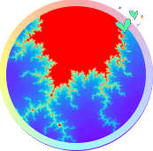
重庆大学
C++编程基础及应用
第7章 函数与抽象
高等教育出版社 第1版
重庆大学 海洋饼干叔叔
使用WPS播放效果最佳

Slide 2


“不满意”是人类进步的阶梯。
——编者

Slide 3
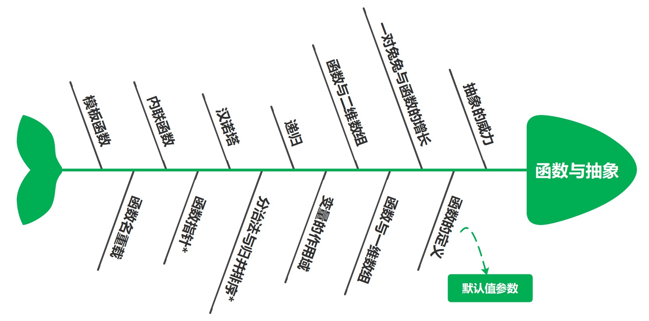
7. 函数与抽象

Slide 4
7.1 抽象的威力
while (true) {
auto cmd = fetchCommandFromQueque();
if (cmd){
auto resp = executeCommand(cmd);
sendResponse(resp);
}
else
sleep(0.01);
readAndParseCommands();
}

Slide 5
7.2 函数的定义
执行结果
f(0) = 1.000000, f(2) = 11.000000, f(-4) = 5.000000
//Project - Quadratic
#include <cstdio>
float f(float); //函数的声明(declaration)或者原型(prototype)
int main(){
printf("f(0) = %f, f(2) = %f, f(-4) = %f", f(0),f(2),f(-4));
return 0;
}
float f(float x){ //函数的定义(definition)
float y = x*x + 3*x + 1;
return y;
}

Slide 6
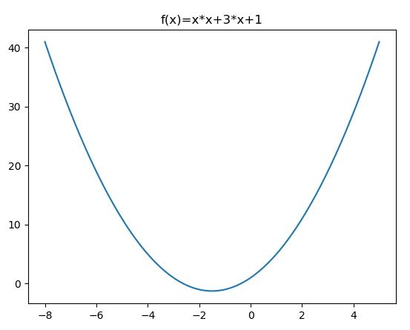
7.2 函数的定义
返回类型 函数名(形参0类型 形参0名称,形参1类型 形参1名称, ... ,形参n类型 形参n名称)
{
语句；
...
return 返回值；
}

Slide 7
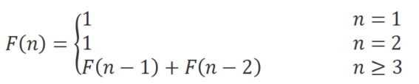
算法 - 一对兔兔与函数的增长
经过月数 | 幼兔对数 | 成兔对数 | 总对数
1 | 1 | 0 | 1
2 | 0 | 1 | 1
3 | 1 | 1 | 2
4 | 1 | 2 | 3
5 | 2 | 3 | 5
6 | 3 | 5 | 8
7 | 5 | 8 | 13
8 | 8 | 13 | 21
9 | 13 | 21 | 34
10 | 21 | 34 | 55
11 | 34 | 55 | 89
12 | 55 | 89 | 144

Slide 8
算法 - 一对兔兔与函数的增长
//Project - Fib
#include <iostream>
#include <iomanip>
using namespace std;
long long fib(int n){
if (n<=2)
return 1;
long long a = 1, b = 1; //最近两项的值，a为前前项，b为前项
long long v = 0;
for (auto i=3;i<=n;i++){
v = a + b; //当前项 = 前前项 + 前项
a = b; b = v; //前前项 = 前项, 前项 = 当前项
}
return v;
}

Slide 9
执行结果
x x^2 x^3 fib(x) ----------------------------------------- 1 1 1 1 12 144 1728 144 24 576 13824 46368 36 1296 46656 14930352 48 2304 110592 4807526976 60 3600 216000 1548008755920
算法 - 一对兔兔与函数的增长
int main() {
cout << setw(4) << left << "x"
<< setw(6) << right << "x^2"
<< setw(10) << right << "x^3"
<< setw(20) << right << "fib(x)" << endl;
cout << "-----------------------------------------" << endl;
for (auto i=0; i<=5; i++){
int x = i==0?1:12*i;
cout << setw(4) << left << x << setfill(' ');
cout << setw(6) << right << x*x;
cout << setw(10) << right << x*x*x;
cout << setw(20) << right << fib(x) << endl;
}
return 0;
}

Slide 10
7.3 函数与一维数组
执行结果
scores = 000000000061FE00 a = 000000000061FE00 average = 70.000000
//Project - AverageArray1
#include <cstdio>
float average(const float a[], const unsigned int n){
printf("a = %p\n",a);
float fSum = 0;
for (unsigned int i=0;i<n;i++)
fSum += a[i];
return fSum / n;
}
int main() {
float scores[5] = {50,60,70,80,90};
printf("scores = %p\n",scores);
float fAvg = average(scores,5);
printf("average = %f",fAvg);
return 0;
}

Slide 11
7.4 函数与二维数组
//Project - AverageArray2
#include <stdio.h>
float average(const float a[][3], const unsigned int n){
float fSum = 0;
for (unsigned int i=0;i<n;i++)
for (unsigned int j=0;j<3;j++)
fSum += a[i][j];
return fSum / (n*3);
}
int main() {
float scores[2][3] = {
{50,60,70},
{80,90,100}
};
float fAvg = average(scores,2);
printf("Average = %f", fAvg);
return 0;
}

Slide 12
7.5 变量的作用域
执行结果
a = 9, &a = 000000000061FE14 b = 6, &b = 000000000061FE18 c = 10, &c = 000000000061FE10 a = 5, &a = 000000000061FE1C b = 6, &b = 000000000061FE18 argc = 1
//Project - BlockScope
#include <cstdio>
int main(int argc, char **argv){
int a = 5;
int b = 6;
{
int a = 9;
int c = 10;
printf("a = %d, &a = %p\n", a, &a); //第9行的内层a
printf("b = %d, &b = %p\n", b, &b); //第6行的外层b
printf("c = %d, &c = %p\n", c, &c); //第10行的内层c
}
printf("a = %d, &a = %p\n", a, &a); //第5行的外层a
//b = c; //错误：b可见，但c不可见
printf("b = %d, &b = %p\n", b, &b); //第6行的外层b
printf("argc = %d", argc); //main()函数的形参
return 0;
}

Slide 13
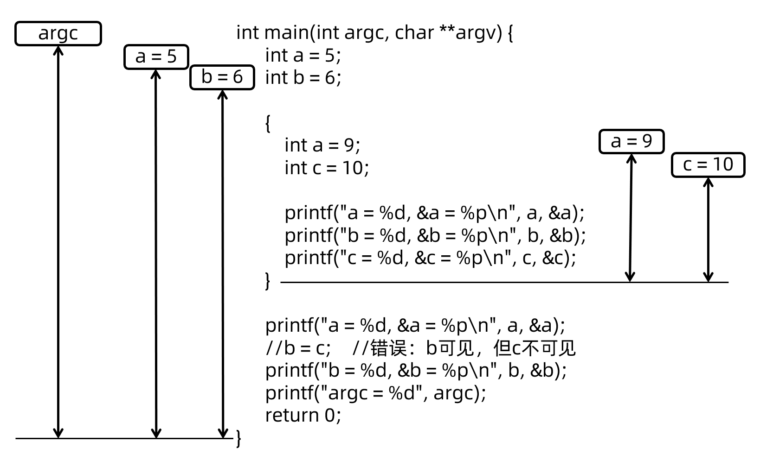
7.5 变量的作用域

Slide 14
7.5 变量的作用域
执行结果
main: &r = 000000000061FE18 getCircleArea: &r = 000000000061FDF0 fArea = 50.265480
//Project - FuncParameter
#include <cstdio>
float PI = 3.1415926F;
float getCircleArea(float r){
printf("getCircleArea: &r = %p\n", &r);
return PI * r * r;
}
int main() {
float r = 4;
printf("main: &r = %p\n", &r);
float fArea = getCircleArea(r);
printf("fArea = %f",fArea);
return 0;
}

Slide 15

7.6 递归

Slide 16
7.6 递归
//Project - Factorial
#include <cstdio>
long long factorial(int n){
printf("factorial(%d) is called, &n = %p\n", n, &n);
if (n==1)
return 1;
long long r = n * factorial(n-1);
return r;
}
int main() {
printf("6! = %lld", factorial(6));
return 0;
}
执行结果
factorial(6) is called, &n = 000000000061FE00 factorial(5) is called, &n = 000000000061FDB0 factorial(4) is called, &n = 000000000061FD60 factorial(3) is called, &n = 000000000061FD10 factorial(2) is called, &n = 000000000061FCC0 factorial(1) is called, &n = 000000000061FC70 6! = 720

Slide 17
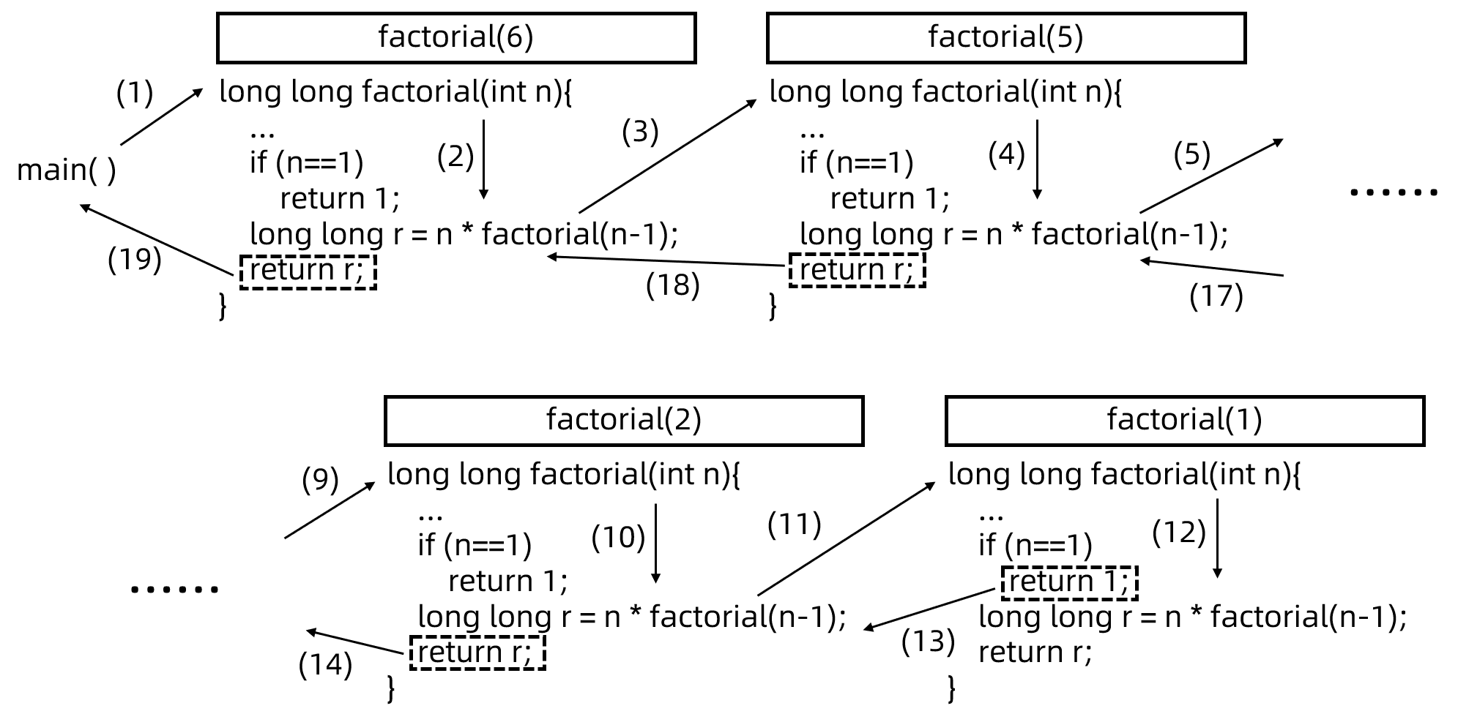

7.6 递归
调试观察递归

Slide 18
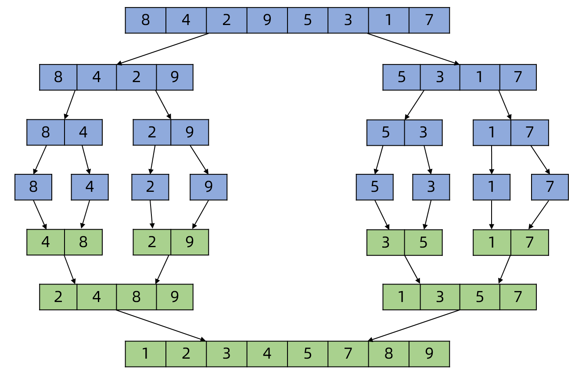

算法 - 分治法及归并排序*
分治法及归并排序

Slide 19
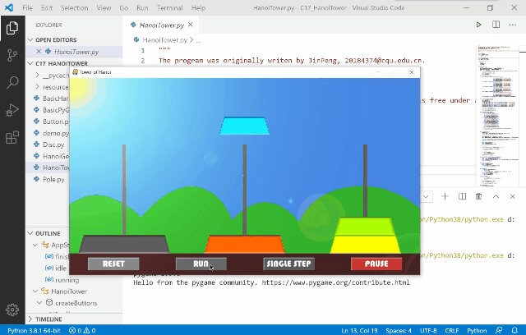
算法 - 汉诺塔*

Slide 20
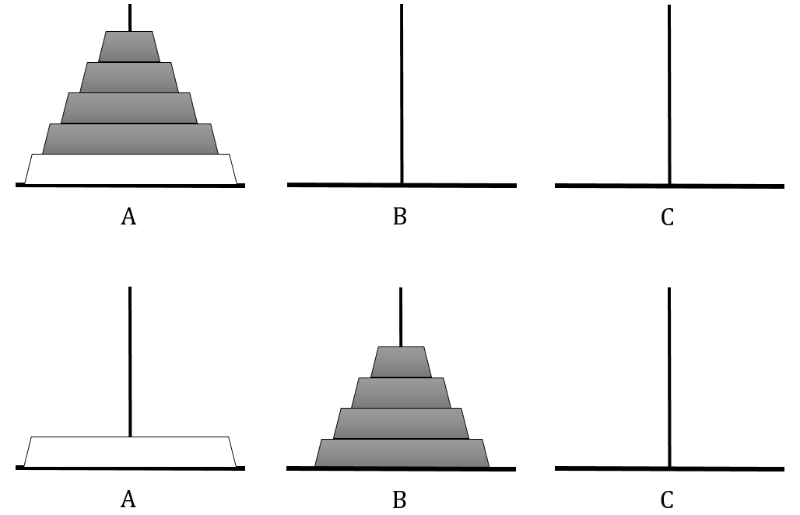
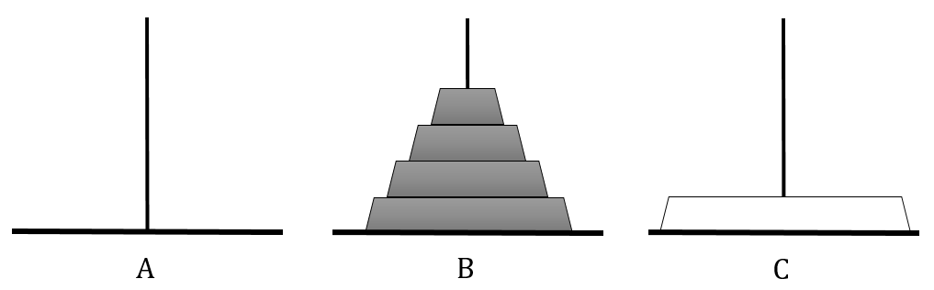
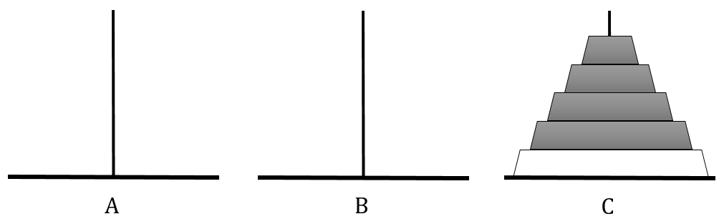
算法 - 汉诺塔*
总任务: 将 n = 5个盘从A柱移至C柱，以B柱为中转柱
子任务1: 将 n - 1 = 4个盘从A柱移至B柱，以C柱为中转柱；
子任务2: 将A柱上的大盘移至C柱； 子作务3： 将n - 1 = 4个盘从B柱移至C柱，以A柱为中转柱。

Slide 21
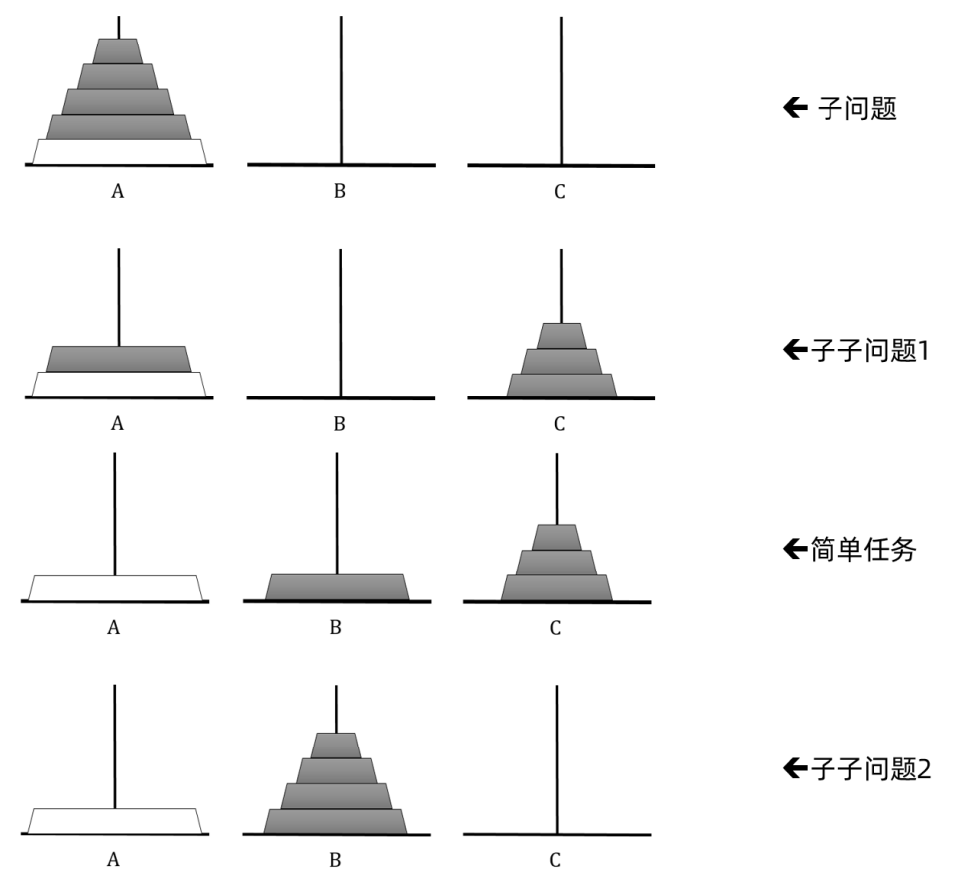
算法 - 汉诺塔*

Slide 22
算法 - 汉诺塔*
int main() {
steps.clear();
hanoi(5,"A","B","C");
cout << "Steps count: " << steps.size() << endl;
cout << "First 3 steps are: " << steps[0] << ", "
<< steps[1] << ", " << steps[2];
return 0;
}
//Project - HanoiTower
#include <iostream>
#include <vector>
#include <string>
using namespace std;
vector<string> steps; //用于存放移盘序列的向量
void hanoi(int n, const char* a, const char* b, const char* c) {
if (n==1)
steps.push_back(string(a) + " --> " + c);
else {
hanoi(n-1, a, c, b);
steps.push_back(string(a) + " --> " + c);
hanoi(n-1, b, a, c);
}
}
执行结果
Steps count: 31 First 3 steps are: A --> C, A --> B, C --> B

Slide 23

算法 - 汉诺塔*
盘数 | 所需移盘次数 | 备注
5 | 31 | 2⁵-1
6 | 63 | 2⁶-1
7 | 127 | 2⁷-1
8 | 255 | 2⁸-1
... | … | …
12 | 4095 | 2¹²-1

Slide 24
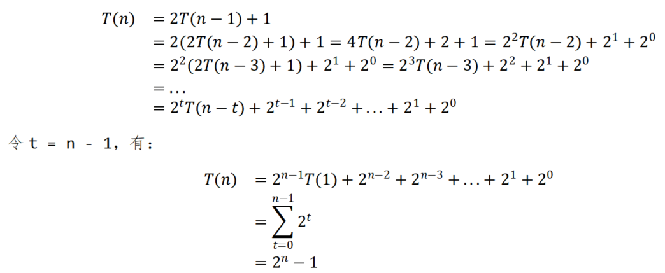

算法 - 汉诺塔*
5949亿年

Slide 25
执行结果
add = 000000401560, &f = 00000061FE18, &c = 00000061FE14 pf = 000000401560, &pf = 00000061FE08 3+2 = 5
7.7 函数指针*
//Project - FuncPointer
#include <cstdio>
int add(int a, short b){
return a + b;
}
int main() {
float f = 3.3F;
int c = 33;
printf("add = %p, &f = %p, &c = %p\n", add, &f, &c);
int (*pf)(int, short) = NULL;
pf = add;
printf("pf = %p, &pf = %p\n", pf, &pf);
int d = pf(3,2);
printf("3+2 = %d", d);
return 0;
}

Slide 26
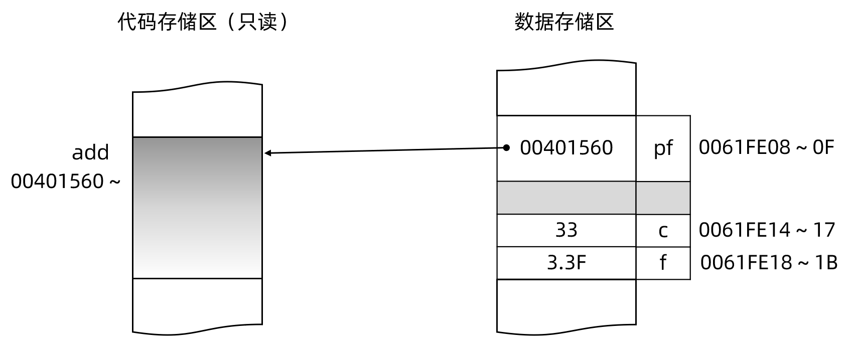
7.7 函数指针*
函数返回值类型 (*函数指针名)(形参0的类型,形参1的类型, ... ,形参n的类型)

Slide 27
7.7 函数指针*
//Project - FuncPointer2
#include <iostream>
#include <string>
using namespace std;
void bubbleSort(string a[],const int n,bool (*bigger)(const string&, const string&)){
for (int i=n-1;i>0;i--)
for (int j=0;j<i;j++){
if (bigger(a[j],a[j+1])){
auto t = a[j];
a[j] = a[j+1];
a[j+1] = t;
}
}
}
bool biggerThan1(const string& a, const string& b){
return a > b;
}
bool biggerThan2(const string& a, const string& b){
return a.size() > b.size();
}

Slide 28
7.7 函数指针*
int main() {
string names[] {"China", "United States", "Russia", "Afghanistan"};
bubbleSort(names, 4, biggerThan1);
cout << "sorted1: " << names[0] << ", " << names[1]
<< ", " << names[2] << ", " << names[3] << endl;
auto pf = biggerThan2;
bubbleSort(names, 4, pf);
cout << "sorted2: " << names[0] << ", " << names[1]
<< ", " << names[2] << ", " << names[3] << endl;
bool (*pfarray[2])(const string&, const string&);
pfarray[0] = biggerThan1;
pfarray[1] = biggerThan2;
pfarray[0]("China","India");
typedef bool (*biggerFunc)(const string&, const string&);
biggerFunc pfarray2[2];
pfarray2[0] = biggerThan1;
pfarray2[1] = biggerThan2;
return 0;
}
执行结果
sorted1: Afghanistan, China, Russia, United States sorted2: China, Russia, Afghanistan, United States

Slide 29
执行结果
1+2 = 3 1+2+3 = 6 1+2+3+4 = 10
7.8 默认值参数
//Project - DefaultParameter
#include <iostream>
using namespace std;
int add(int a, int b, int c = 0, int d = 0){
return a + b + c + d;
}
int main() {
cout << "1+2 = " << add(1,2) << endl;
cout << "1+2+3 = " << add(1,2,3) << endl;
cout << "1+2+3+4 = " << add(1,2,3,4) << endl;
return 0;
}

Slide 30
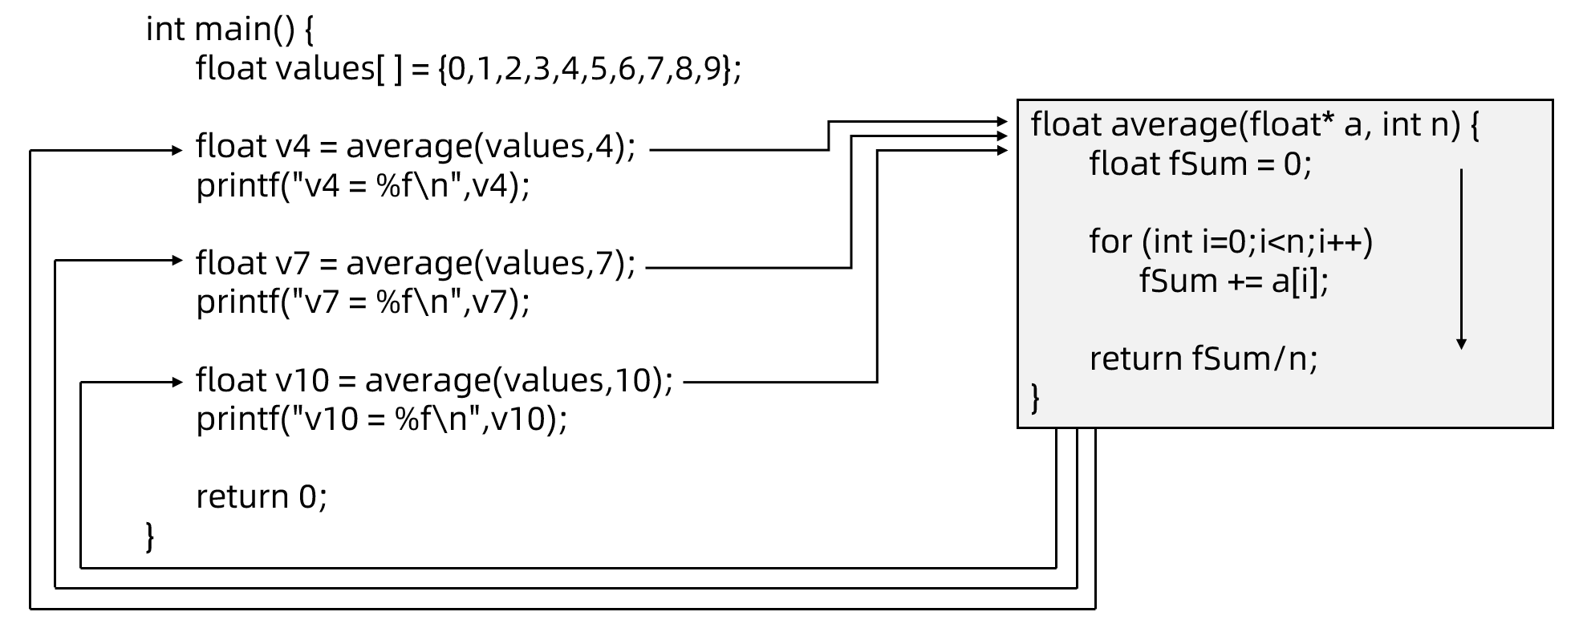
7.9 内联函数
非内联函数的调用与返回

Slide 31
执行结果
v4 = 1.5 v7 = 3 v10 = 4.5
7.9 内联函数
//Project - MultiCall
#include <iostream>
using namespace std;
inline float average(float* a, int n) {
float fSum = 0;
for (int i=0;i<n;i++)
fSum += a[i];
return fSum/n;
}
int main() {
float values[] = {0,1,2,3,4,5,6,7,8,9};
float v4 = average(values,4);
cout << "v4 = " << v4 << endl;
float v7 = average(values,7);
cout << "v7 = " << v7 << endl;
float v10 = average(values,10);
cout << "v10 = " << v10 << endl;
return 0;
}

Slide 32
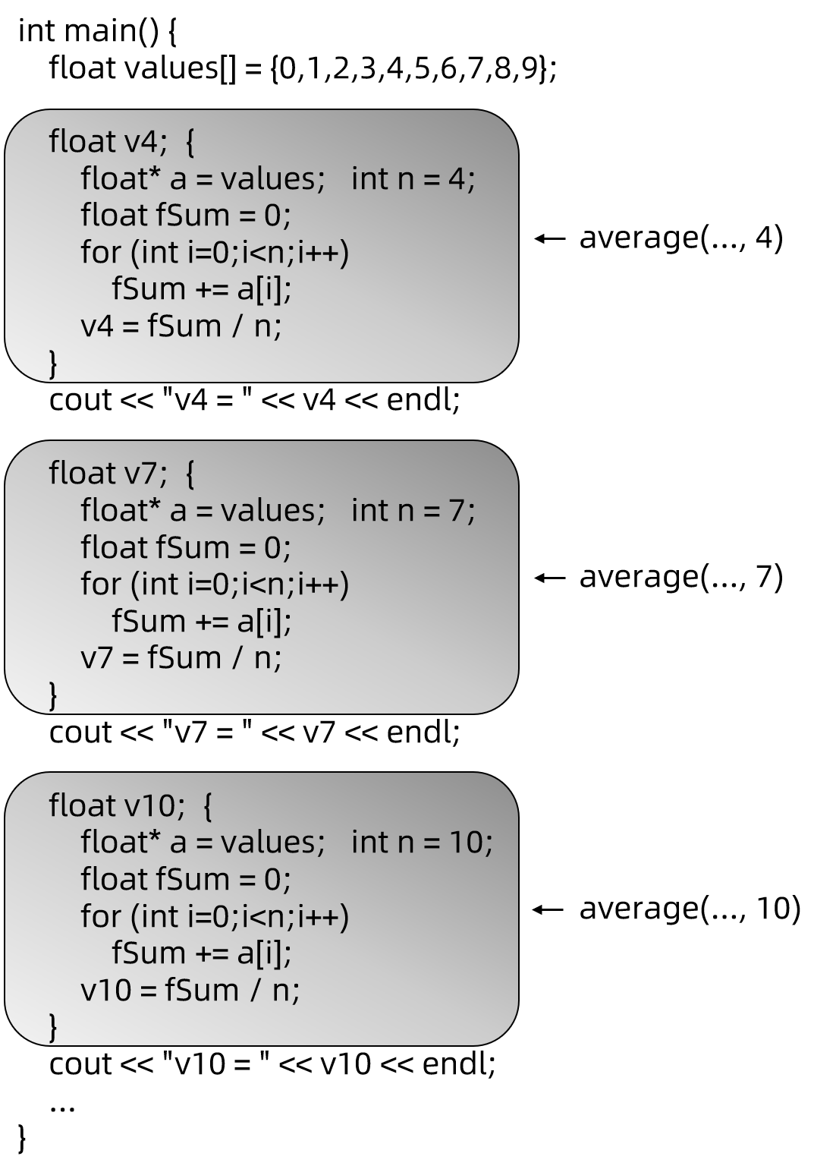
7.9 内联函数

Slide 33
执行结果
before setBit: 00000000000000000000000000000000 after setBit: 10000000000000000000100000000001
7.9 内联函数
//Project - InlineExample
#include <iostream>
#include <bitset>
using namespace std;
//将无符号整数v的第bit位设置为1
inline void setBit(unsigned int& v, int bit){
v |= (0x01 << bit);
}
int main() {
unsigned int v = 0x00000000;
cout << "before setBit: " << bitset<32>(v) << endl;
setBit(v,0);
setBit(v,31);
v |= (0x01 << 11);
cout << "after setBit: " << bitset<32>(v) << endl;
return 0;
}

Slide 34
int main() {
double d1 {1.1}, d2{9.9};
swapObject(d1,d2);
cout << "d1 = " << d1 << ", d2 = " << d2 << endl;
float f1 {2.2}, f2 {8.8};
swapObject(f1,f2);
cout << "f1 = " << f1 << ", f2 = " << f2 << endl;
return 0;
}
7.10 函数名重载
//Project - FuncOverloading1
#include <iostream>
using namespace std;
void swapObject(float& a, float& b){
cout << "swapObject_float,a=" << a << ",b=" << b << endl;
auto t = a;
a = b;
b = t;
}
void swapObject(double& a, double& b){
cout << "swapObject_double,a=" << a << ",b=" << b << endl;
auto t = a;
a = b;
b = t;
}
执行结果
swapObject_double,a=1.1,b=9.9 d1 = 9.9, d2 = 1.1 swapObject_float,a=2.2,b=8.8 f1 = 8.8, f2 = 2.2

Slide 35
7.11 模板函数
int main() {
char c1 {'a'}, c2 {'z'};
swapObject(c1,c2);
cout << "c1 = " << c1 << ", c2 = " << c2 << endl;
double d1{1.1}, d2{9.9};
swapObject(d1,d2);
cout << "d1 = " << d1 << ", d2 = " << d2 << endl;
short s1{-22}, s2{22};
swapObject<short>(s1,s2);
cout << "s1 = " << s1 << ", s2 = " << s2 << endl;
return 0;
}
//Project - TemplateSwap
#include <iostream>
using namespace std;
template <typename T>
void swapObject(T& a, T& b){
auto t = a;
a = b;
b = t;
}
执行结果
c1 = z, c2 = a d1 = 9.9, d2 = 1.1 s1 = 22, s2 = -22

Slide 36
End of Chapter 7
重庆大学 海洋饼干叔叔

